Slide 1
Chapter 8
Chemical Composition

Slide 2
Jellybeans
Suppose you work in a candy store that sells gourmet jelly beans by the bean.
Can we count these nonidentical beans by weighing?
  Yes. The key piece of information we need is the average mass of the jelly beans.
For purposes of counting, the objects behave as though they were all identical, as though they each actually had the average mass.
The same concept applies in chemistry.

Slide 3
Think, Pair, Share Activity – Unit 8.1
Can you think of any other items that are counted by weighing? Turn to your neighbor and discuss some examples.

Slide 4
Atoms
Individual atoms are far too small to see.
We must learn to count atoms by weighing samples containing large numbers of them.
Because atoms are so tiny, the normal units of mass—the gram and the kilogram—are much too large to be convenient.

Slide 5
Atomic Mass Units
Scientists have defined a much smaller unit of mass called the atomic mass unit (amu).
1 amu = 1.66 × 10^{–24} g
Table 8.1 Average Atomic Mass Values for Some Common Elements
Element | Average Atomic Mass (amu)
Hydrogen | 1.008
Carbon | 12.01
Nitrogen | 14.01
Oxygen | 16.00
Sodium | 22.99
Aluminum | 26.98

Slide 6
Elements
Let’s assume we have a sample of aluminum that has a mass of 26.98 g.
What mass of copper contains exactly the same number of atoms as this sample of aluminum?
Because the average masses of aluminum and copper atoms are 26.98 amu and 63.55 amu, respectively, 26.98 g of aluminum and 63.55 g of copper contain exactly the same number of atoms.
Remember, samples in which the ratio of the masses is the same as the ratio of the masses of the individual atoms always contain the same number of atoms.

Slide 7
The Mole
The mole (mol) can be defined as the number equal to the number of carbon atoms in 12.01 grams of carbon.
Techniques for counting atoms very precisely have been used to determine this number to be 6.022 × 10²³.
This number is called Avogadro’s number.
One mole of something consists of 6.022 × 10²³ units of that substance.

Slide 8
Critical Thinking Activity – Unit 8.3
What if you were offered $1 million to count from 1 to 6 × 10²³ at a rate of one number each second?
Determine your hourly wage. Would you do it? Could you do it?

Slide 9
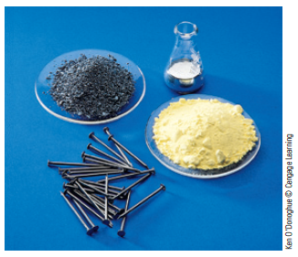
One Mole
Table 8.2 Comparison of 1-Mole Samples of Various Elements
Element | Number of Atoms Present | Mass of Sample (g)
Aluminum | 6.022 × 10²³ | 26.98
Gold | 6.022 × 10²³ | 196.97
Iron | 6.022 × 10²³ | 55.85
Sulfur | 6.022 × 10²³ | 32.07
Boron | 6.022 × 10²³ | 10.81
Xenon | 6.022 × 10²³ | 131.3

Slide 10
Mole Conversion Example
How many H atoms are present in a sample with a mass of 0.500 g?
1 mol H atoms = 1.008 g H
1 mol = 6.022 × 10²³

Slide 11
Mole Conversion Practice
Convert each of the following amounts to moles:
3.60 g Al

Slide 12
T
544 g Ca

Slide 13
Atom Conversion Practice
Determine the number of atoms in each of the following amounts:
0.133 mol Al

Slide 14
Continued practice
13.6 mol Ca

Slide 15
Convert atoms to grams
2.31x10²² atoms of gold

Slide 16
Complex Problems
Being able to solve complex problems is a talent that will serve you well in all walks of life.
It is our purpose in this text to help you learn to solve problems in a flexible, creative way based on understanding the fundamental ideas of chemistry.
We call this approach conceptual problem solving.

Slide 17
Conceptual Problem Solving – Principle 1
To help us as we proceed to solve a problem, the following organizing principles will be useful to us.
First, we need to read the problem and decide on the final goal.
  Then we sort through the facts given, focusing on keywords and often drawing a diagram of the problem.
  In this part of the analysis, we need to state the problem as simply and as visually as possible.
  We can summarize this process as “Where Are We Going?”

Slide 18
Conceptual Problem Solving – Principle 2
We need to work backward from the final goal in order to decide where to start.
  For example, in a stoichiometry problem we always start with the chemical reaction.
  Then as we proceed, we ask a series of questions, such as “What are the reactants and products?,” “What is the balanced equation?,” and “What are the amounts of the reactants?”
  Our understanding of the fundamental principles of chemistry will enable us to answer each of these simple questions and eventually will lead us to the final solution.
  We can summarize this process as “How Do We Get There?”

Slide 19
Conceptual Problem Solving – Principle 3
Once we get the solution of the problem, then we ask ourselves: “Does it make sense?” That is, does our answer seem reasonable?
  We call this the Reality Check.
  It always pays to check your answer.

Slide 20
TopHat

Slide 21
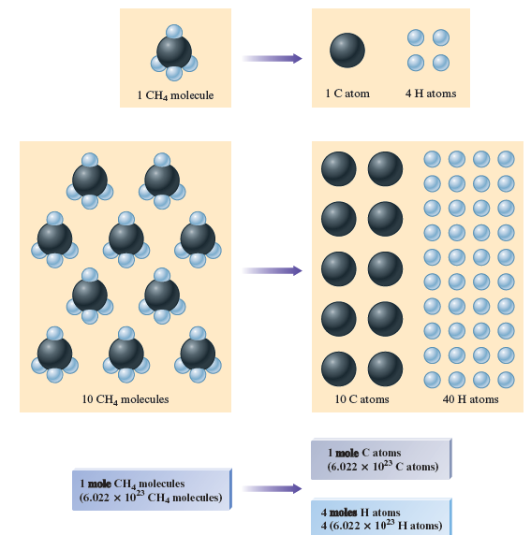
From Molecules to Moles

Slide 22
Molar Mass
The mass of 1 mole of methane can be found by summing the masses of carbon and hydrogen present:
Mass of 1 mol C = 1 × 12.01 g | = 12.01 g
Mass of 4 mol H = 4 × 1.008 g | = 4.032 g
Mass of 1 mol CH₄ | = 16.04 g
The quantity 16.04 g is called the molar mass for methane: the mass of 1 mole of CH₄ molecules.
The molar mass of any substance is the mass (in grams) of 1 mole of the substance.
  The molar mass is obtained by summing the masses of the component atoms.

Slide 23
Calculating Molar Mass Practice
Calculate the molar mass of the following compounds:
NH₃

Slide 24
More practice
H₂SO₄

Slide 25
Continue to practice
C₆H₁₂O₆

Slide 26
LA problem
Find the molar mass of barium hydroxide
Ba(OH)₂
137.33 + 2(17.01) = 171.35 g/mol

Slide 27
Calculating Mass from Moles Practice
A sample of NaOH contains 7.89 moles. What is the mass in grams of this sample?

Slide 28
Calculating Moles from Mass Practice
A sample of Fe₂O₃ weighs 982 g. How many moles does the sample contain?

Slide 29
LA problem 1
9.43 mg of calcium chloride.

Slide 30
Mass Percent
The mass fraction for each element is calculated as follows:
The mass fraction is converted to mass percent by multiplying by 100%.

Slide 31
Mass Percent of Ethanol
Ethanol has the formula C₂H₅OH

Slide 32
Calculating Mass Percent Practice
What is the mass percent of each element in H₃PO₄?

Slide 33
TopHat 1
Mass percent for magnesium iodite

Slide 34
Formulas of Compounds
The formula of a compound represents the relative numbers of the various types of atoms present.
  For example, the molecular formula CO₂ tells us that for each carbon atom there are two oxygen atoms in each molecule of carbon dioxide.
Sometimes a chemical reaction gives a product that has never been obtained before.
  In such a case, a chemist determines what compound has been formed by determining which elements are present and how much of each. These data can be used to obtain the formula of the compound.

Slide 35
What if you are given a percent composition?
What if a compound has 32.000% carbon, 6.714% hydrogen, 42.630% oxygen, and 18.660% nitrogen?
Step 1:
Consider the percentage to be the number of grams in a 100 gram sample:
32.000 g C
6.714 g H
42.630 g O
18.660 g N
Notes:
If you start out with a percent composition of a material you can easily get to its empirical formula. If you consider a 100 g sample you can convert the percentage of each element into grams of that element as we see here.

Slide 36
Combustion analysis continued
Step 2:
Find the moles of each element:
32.000 g C
_______________
=
2.664 mol C
12.01 g C/mol C
6.714 g H
_______________
=
6.648 mol H
1.01 g H/mol H
42.630 g O
_______________
=
2.664 mol O
16.00 g O/mol O
18.660 g N
_______________
=
1.333 mol N
14.00 g N/mol N
Notes:
For the second step you need to find the number of moles of each element. This step and the next are the same as before when we started finding empirical formulas with grams.

Slide 37
Finding the empirical formula
Step 3:
Divide each by the smallest number of moles:
2.664 mol C
_______________
=
2 C
1.333 mol
6.648 mol H
_______________
=
5 H
1.333 mol
C₂H₅O₂N
2.664 mol O
_______________
=
2 O
1.333 mol
1.333 mol N
_______________
=
1 N
1.333 mol
Notes:
Now we find the ratio of each element in the formula by dividing by the smallest number of moles. This should leave us integer answers. Then recombine the elements into your formula. Work homework problems 3 and 4 now for practice with this material

Slide 38
Percent composition to formula
A compound has the following percent composition
C = 9.94%
Cl = 58.6%
F = 31.4%

Slide 39
Empirical and Molecular Formulas
The formula of a compound that expresses the smallest whole-number ratio of the atoms present is called the empirical formula or simplest formula.
  A compound that contains the molecules C₄H₈O₄ has the same empirical formula as a compound that contains C₆H₁₂O₆ molecules.
  The empirical formula for both is CH₂O.
The actual formula of a compound—the one that gives the composition of the molecules that are present—is called the molecular formula.

Slide 40
Empirical Formulas Practice
What are the empirical formulas of the following compounds?
H₂O₂
C₄H₈O₂
P₄O₁₀

Slide 41
Calculation of Empirical Formulas
One of the most important things we can learn about a new compound is its chemical formula.
To calculate the empirical formula of a compound, we first determine the relative masses of the various elements that are present.
One way to do this is to measure the masses of elements that react to form the compound.

Slide 42
Steps for Determining the Empirical Formula of a Compound – Steps 1-3
Obtain the mass of each element present (in grams).
Determine the number of moles of each type of atom present.
Divide the number of moles of each element by the smallest number of moles to convert the smallest number to 1.
  If all of the numbers so obtained are integers (whole numbers), these are the subscripts in the empirical formula.
  If one or more of these numbers are not integers, go on to step 4.

Slide 43
Steps for Determining the Empirical Formula of a Compound – Step 4
Multiply the numbers you derived in step 3 by the smallest integer that will convert all of them to whole numbers.
  This set of whole numbers represents the subscripts in the empirical formula.

Slide 44
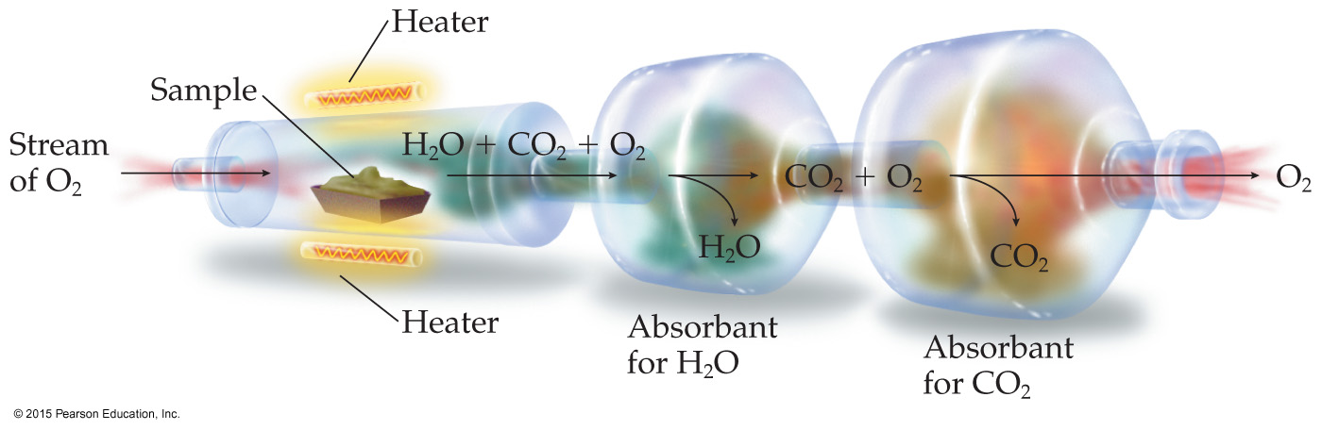
Combustion analysis
A common technique called combustion analysis is good for determining the empirical formulas of carbon containing compounds. This works by burning the sample in excess oxygen so that it full converts to products.
When we do this, we can find the percent of carbon and the other elements which leads us to the empirical formula of the material being identified.

Slide 45
Empirical formulas
Chemists often react different amounts of material together to see what is formed. In an experiment a chemist reacted 1.198 g of carbon with 0.302 g of hydrogen. This made 1.500 g of our new material. What is the empirical formula?
Step 1:
Find the mole of each by taking the mass and dividing by the molar mass:
1.198 g C
0.302 g H
_______________
=
0.0998 mol C
_______________
=
0.299 mol H
12.01 g C/mol C
1.01 g H/mol H
Notes:
Since you start with a mass of each element you can use the molar mass of each element to find the total number of moles of each element. The number of moles of each element can be any number, it does not have to be an integer. Once you know how many moles of each element you can go on to the next step which is finding the ratio between the elements.

Slide 46
Finding the empirical formula-2
Step 2:
Take the larger number of moles and divide it by the smaller number of moles:
0.299 mol H
3H
_______________
=
____
0.0998 mol C
1C
Step 3:
Now take the coefficient from each element and use it as the subscript:
CH₃
Notes:
Find the smallest number of moles. In this case we have 0.0998 moles of carbon and 0.299 moles of hydrogen. In a binary compound you can divide the larger by the smaller number to get a ratio. Here we see that 0.0998 goes in to 0.299 nearly 3 times (it is exactly 2.996). Since we can’t have a fraction of an atom we will use the integer 3 for the number of hydrogens and 1 for the number of carbons. Do not worry if you end up with a fraction, if it is not very close to the whole number, such as 2.66, then you have a ratio with a fraction that needs to be resolved. This same method can be applied to compounds with multiple elements. The main difference is you will take the number of moles of each and divide that by the smallest number of moles.

Slide 47
From Empirical to Molecular Formula
If we know the composition of a compound in terms of the masses (or mass percentages) of the elements present, we can calculate the empirical formula but not the molecular formula.
To obtain the molecular formula we must know the molar mass.

Slide 48
Calculation of Molecular Formulas
The molecular formula is always an integer multiple of the empirical formula.
  For example, the sugar glucose has the empirical formula CH₂O and the molecular formula C₆H₁₂O₆.
In general, we can represent the molecular formula in terms of the empirical formula as follows:
(Empirical formula)_{n} = molecular formula

Slide 49
LA Pracitce
C₄H₅N₂O
MM is 194.14 g/mol

Slide 50
Think, Pair, Share Activity – Unit 8.9
Turn to your neighbor and discuss why knowing the molecular formula is generally more useful than knowing the empirical formula.

